Slide 1

DevOps & Cloud Infrastructure SEIS 665 AWS Integration, Management & Security
Jason Baker
Adjunct Instructor
Graduate Programs in Software
University of St. Thomas
St. Paul, MN

Slide 2
Agenda
Cloud-native application architecture
AWS
Cloud Watch
EC2 Auto-scaling
SNS
SQS
SES
Route 53
Elastic Beanstalk
AWS Security
Shield
WAF
Guard Duty
KMS

Slide 3
Cloud-native application architecture
The way we build applications for the cloud is fundamentally different than the way we traditionally built apps.
Many legacy applications were never designed to run in cloud platforms, and therefore don't run very well.
Some legacy applications can move to the cloud, but cloud applications cannot move to traditional datacenters. *
* AWS Outpost allows you to stand up a rack of servers in your private datacenter to run a limited set of AWS services.

Slide 4
Cloud-native application architecture
Cloud-native application characteristics:
Composed of multiple small services (micro-services) instead of a single monolithic application.
Highly dependent on network layer for application service communications.
Leverage managed services supported by the cloud provider.
Deployed across multiple availability zones and regions for higher resiliency.

Slide 5

Cloud-native application architecture

Slide 6
Cloud-native application architecture
The danger of cascading service calls:
Even if every service were available 99.999% of the time, with hundreds of services only 99% of the requests would be fulfilled.
We can mitigate some of these issues using:
Retries (be careful!)
Caching
Many modern applications are moving towards an event-driven model.

Slide 7
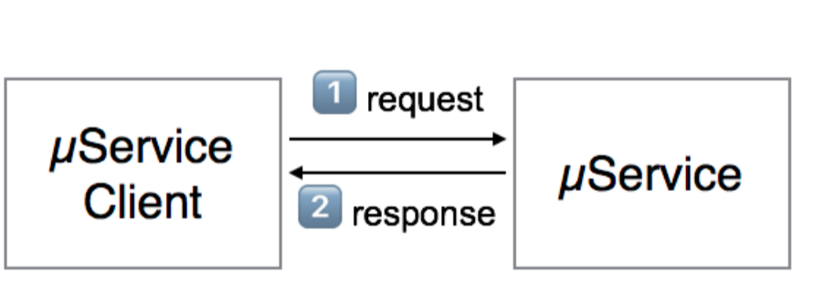
Request/Response Pattern

Slide 8
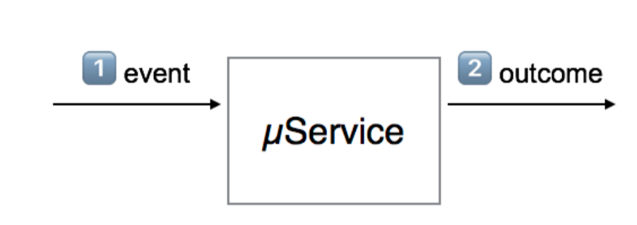
Event-driven Pattern

Slide 9
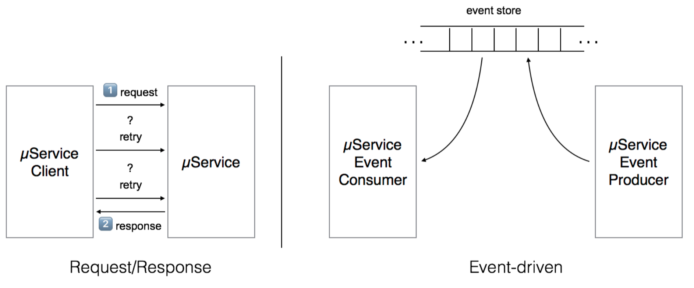
Request/Response vs Event-driven

Slide 10
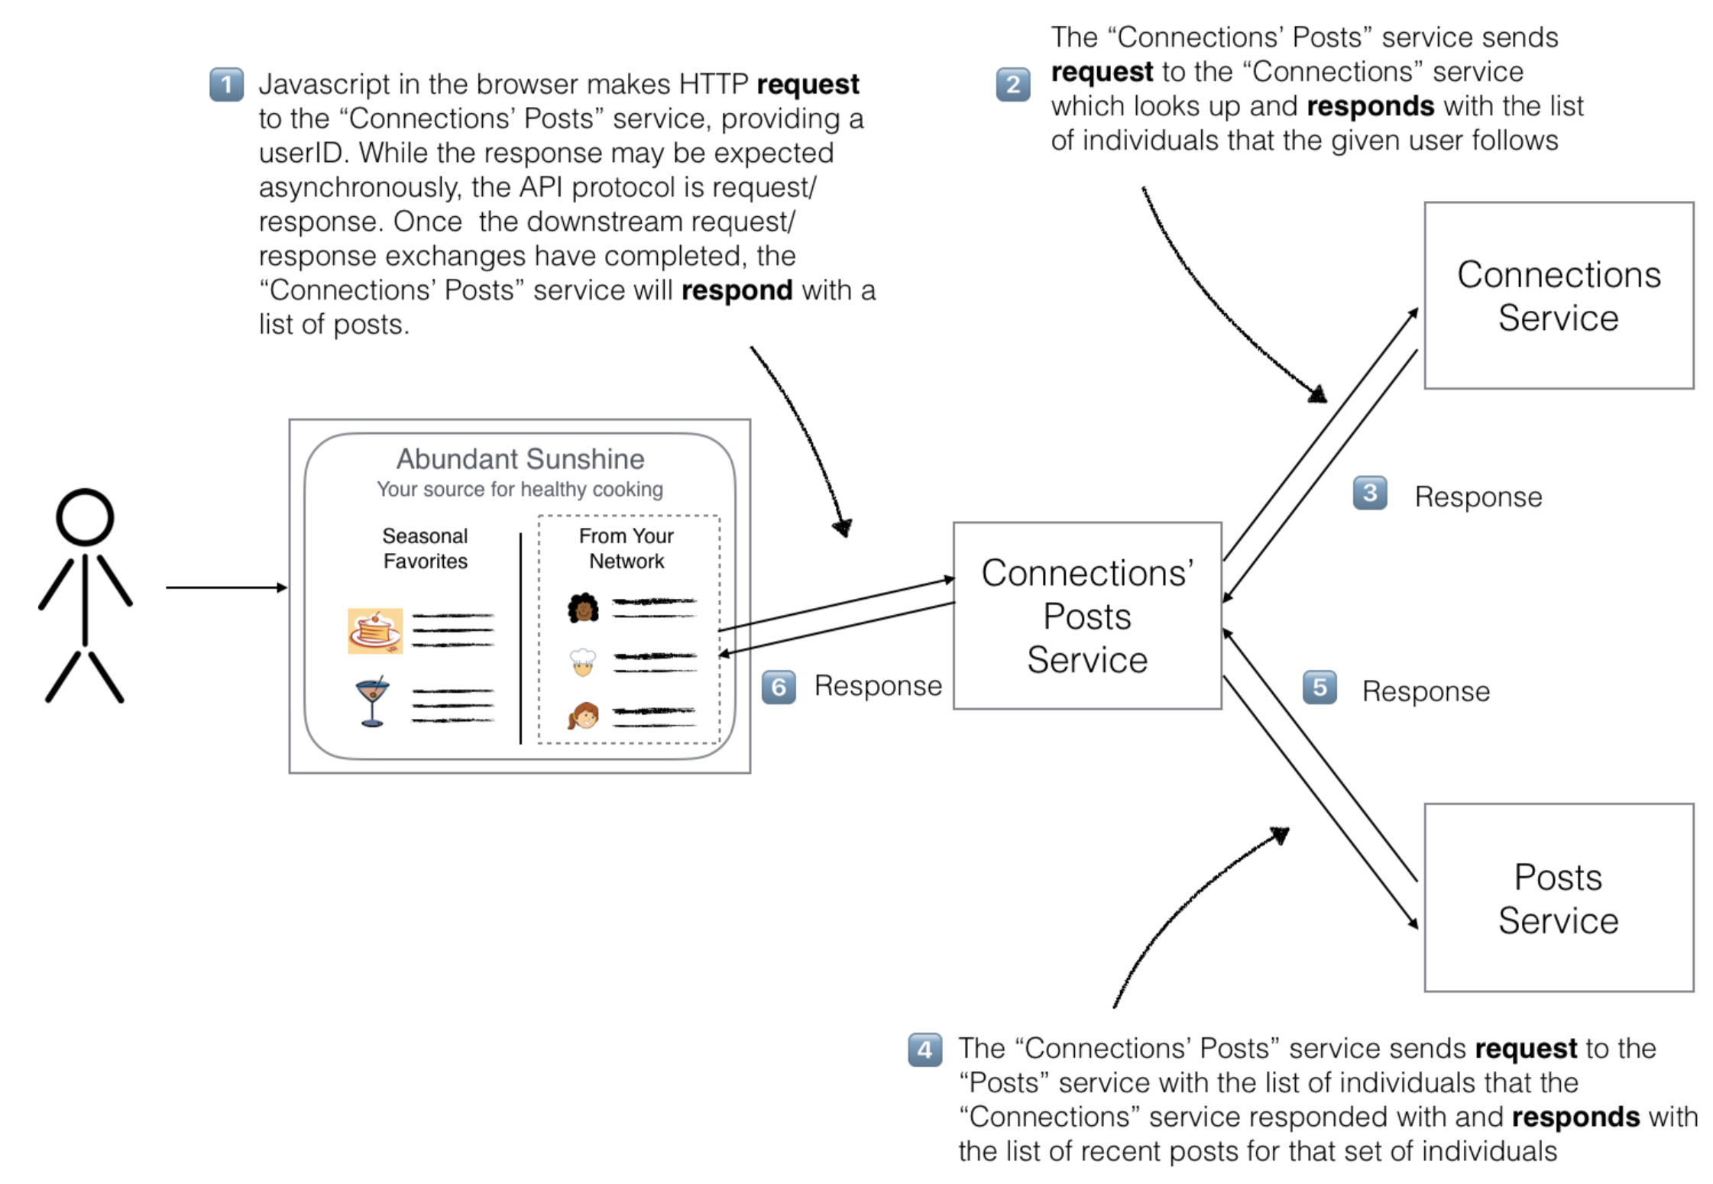

Slide 11
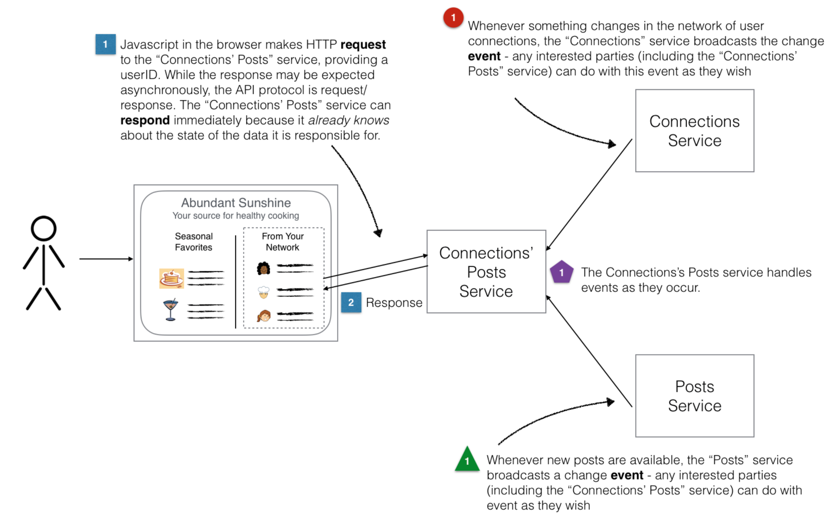

Slide 12
Circuit Breaker pattern
Cloud-native applications consist of services which call services which call services…
Our platform may experience cascading service failures:
One or more services generating huge demand for a shared service.
A shared service which becomes unresponsive creates failures in other parts of the platform.

Slide 13
Circuit Breaker pattern
Solution: services invoke one another through an abstraction layer which acts like an electrical circuit breaker.
Service blocks requests when external service is no longer available.

Slide 14
Bulkhead Pattern
In a shared platform one customer may generate demand which impacts other customers (noisy-neighbor problem).
Solution: partition customer resources into separate resource pools.

Slide 15
Retry Pattern
Transient failures are common in cloud-native applications and should be handled elegantly.
Solution: a service automatically tries to reconnect to another service after a connection failure.
We usually introduce a delay between re-connection attempts.
Many services trying to reconnect to a shared service may generate a retry storm!
In practice we always try to implement an exponential back-off delay when retrying connections.

Slide 16
Pipes and Filters Pattern
A monolithic application may perform a series of processing steps on a data set.

Slide 17
Pipes and Filters Pattern
Cloud-native apps partition processing into separate components (called filters) that may be connected together to form a pipeline.

Slide 18

CloudWatch
CloudWatch is a monitoring service for AWS resources and applications.
Track performance metrics
Collect and monitor log files
Set alarms based on predefined thresholds
Supports EC2, RDS, DynamoDB, and other services.
Basic monitoring is free, detailed monitoring costs extra.
Increased interval from 5 min to 1 min
Monitor custom app metrics using an API

Slide 19
CloudWatch Instrumentation

Slide 20

CloudTrail
A service that logs all AWS API calls for tracking, reporting and compliance purposes.
A stream of logging data is called a trail.
Log data is stored in a designated S3 bucket.
Trail can contain logs from all regions or a specified region.
Maximum of 5 trails per region.
Ability to setup notification when specific API calls are made.
Example: Notify when API call adds or removes EC2 instances.

Slide 21

AWS Config
A service that evaluates and documents the configuration of AWS resources.
Can review resources globally or just in a specific region.
Can review all resources or just selected ones.
Use cases:
Take snapshots of resource configurations to review changes over time.
Audit resource configuration for compliance purposes.
Verify that all EBS volumes are encrypted.
Verify that resources are tagged properly.
Reports are stored in a designated S3 bucket.
Service can send notifications if a resource configuration changes.

Slide 22

EC2 Auto Scaling
Auto scaling allows you to scale EC2 capacity up or down based on defined conditions.
Ensure a certain number of instances are always running.
Increase or decrease number of instances to support current demand and save costs.
Only billed for instances created by Auto Scaling, not the service itself.

Slide 23
EC2 Auto Scaling
Two components of auto scaling configuration:
Launch Configuration: specifies the type of EC2 instance created during the auto scaling process.
Very similar to launching an EC2 instance, in this case just the configuration is created.
Auto Scaling Group: defines a set of EC2 instances and the the conditions which determine the number of instances in the set.

Slide 24
EC2 Auto Scaling
Auto Scaling Group configurations:
Maintain minimum number of instances: automatically launches new instances if a current instance becomes unhealthy.
Manual scaling: user manually changes auto scaling group configuration and AWS adjust instance count to match new configuration.
Dynamic scaling: instances launched or removed based on CloudWatch metrics and alarms.

Slide 25

Auto Scaling Hands On
Create a launch configuration.
Create an auto scaling group.
Group size = 2
Keep group at its initial size
Watch AWS automatically launch EC2 instances.
Manually fail one of the instances and watch automatic recovery.

Slide 26

Simple Notification Service (SNS)
SNS makes it easy to publish messages from an application and deliver them to subscribers or other applications.
Send messages via:
Email
SMS (text message)
Mobile push (Apple, Google, Fire OS, Windows)
SQS queues
HTTP endpoints

Slide 27
SNS
A topic is created as an access point to allow multiple recipients to receive a message.
A single topic can support multiple endpoint types
Messages published to SNS are stored in multiple AZs for redundancy.
Recipients must subscribe to a topic in order to receive published messages.
Messages are pushed to topic recipients.
Use-cases: event notifications (triggers, alerts, auto scaling notifications, etc.)

Slide 28
SNS
Publisher-Subscriber (pub/sub) pattern:
Allow application to provide events to multiple subscriber applications asynchronously.
The publisher and subscriber applications don't have to be aware of one another (loose coupling).

Slide 29

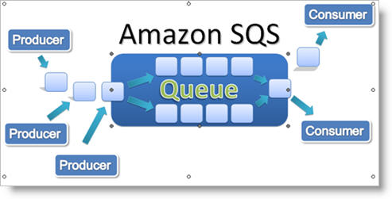
Simple Queue Service (SQS)
SQS is a distributed queue system that allows messages generated by one system component to be consumed by another.
First web service launched by Amazon in 2005.
Asynchronous application integration: message producers are decoupled from consumers

Slide 30
SQS
SQS use cases:
Create thumbnails from user uploaded images or apply watermarks.
Video transcoding
Support payment process workflow for orders.
Scale bursty applications that are trying to balance data consumption with backend data processing.
Messages are added to a queue by an application, and then pulled from the queue by another application.
Consumer app must process message within a certain amount of time called the visibility timeout.
Consumer app must delete the message from the queue when complete.

Slide 31
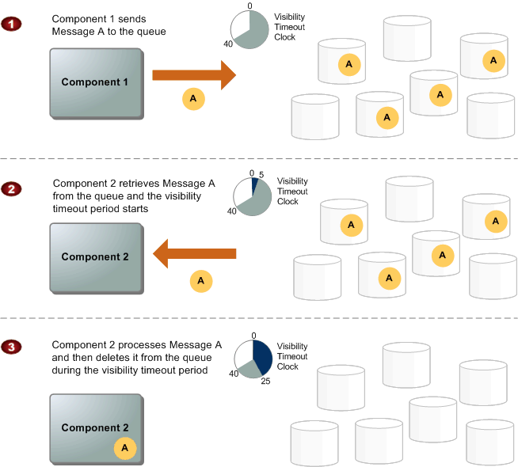

Slide 32
SQS
SQS guarantees that a message will be received at least once (but possibly more than once!)
Action taken on message should be idempotent (repeat action multiple times with same result).
Because messages are pulled, requests must be made every few seconds to see if anything in the queue.
1 request every 5 sec = 12*60*24*7*4.3= 520,128/mo
4 backend workers > 2 million requests/mo
Wasteful requests if queue is empty at times
Long polling: keep message pull call open for up to 20 seconds, streaming in new messages as they arrive.

Slide 33
SQS
Competing Consumers pattern:
Allow multiple applications to read from the same message queue.
Process requests independently in parallel.
Highly resilient, but no guarantee of order.

Slide 34
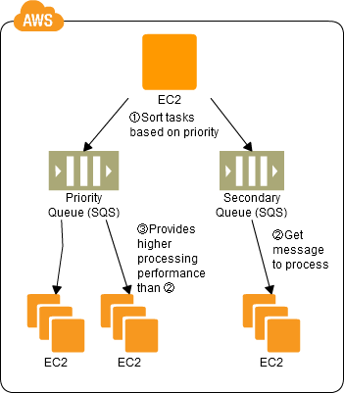
SQS Priority Queuing
SQS doesn’t support the concept of prioritization, but you can use multiple queues to accomplish the same thing.

Slide 35
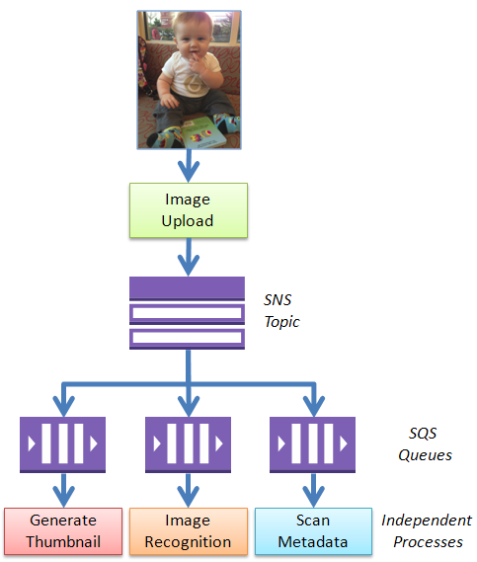
SQS Fan-out

Slide 36
SQS Hands On
Create an SQS queue.
Add a message to the queue with a publisher app.
Check for messages on the queue.
Pull a message from the queue with a subscriber app.

Slide 37

Simple Email Service (SES)
SES is a scalable email service to support sending and receiving email from AWS.
AWS customers must get approval to run mail servers (smtp) on EC2 instances.
Messages sent via standard SMTP, received messages are stored in S3.
Billing is based on number of messages sent and received per month (first 62k sent free).
AWS places a limit on number of messages sent/day, but you can request an increase.

Slide 38

Route 53
Scalable domain name hosting and registration service.
Route 53 name is based on famous Route 66 highway across America, 53 is DNS port number.
Domain Name Services (DNS) are a critical part of Internet infrastructure
DNS translates domain names (domain.com) into IP addresses.
Availability of DNS services directly impacts service availability.
Service isn’t really “up” if nobody can find it.

Slide 39
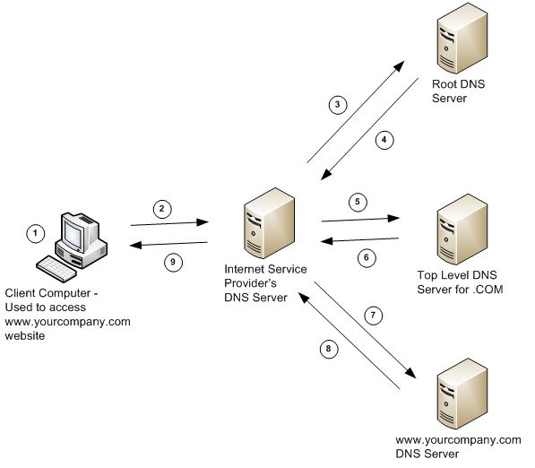
Route 53
How DNS Works

Slide 40
Route 53
AWS can serve as a domain registrar and name server.
A name server provides all authoritative records for a domain name.
Record types:
Start of authority (SOA): administrator name, version, and TTL information
Name Server (NS): used by top level servers to locate authoritative name server
Address (A): maps a hostname to an IP address
CNAME: maps a hostname to a fully qualified domain name
Alias: like a CNAME, but can use dynamic AWS targets
Example: Elastic load balancers use a dynamic endpoint, not an IP address

Slide 41
Route 53 Routing Policies
Routing policies are used to distribute traffic over multiple regions using dynamic DNS responses.
Simple: default policy which maps a DNS request to one or more addresses (random).
Multivalue Answer: same as simple policy except Route 53 will perform health check and only respond with healthy records.
Weighted: distribute traffic over multiple regions based on the weighting assigned to each region.
Example: 85% us-east, 15% us-west)
May be useful for A/B testing
Latency: distribute traffic by directing user to the lowest latency region.
Example: US customers directed to us-east and European customers direct to eu-west

Slide 42
Route 53 Routing Policies
Failover: monitor health of services and fail over to a secondary region if health check fails.
Example: us-east is primary, us-west is secondary
Primarily used for disaster recovery purposes, protect against failure of an entire region
Geolocation: distribute traffic to a specific region based on physical location of user.
Example: All queries from European users go to eu-west
Primarily used to meet regulatory and data privacy requirements
Geoproximity Routing (Traffic flow): route traffic based on both physical location of user and location of resources.
Able to define a bias setting which expands or shrinks geographic region
Must use Route 53 traffic flow when enabling this configuration

Slide 43
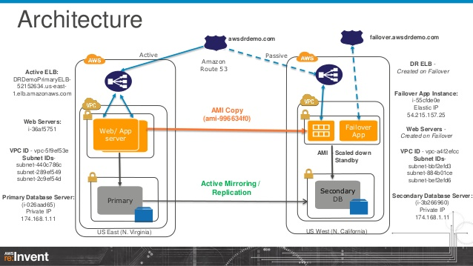
DR Architecture Using Route 53

Slide 44

Elastic Beanstalk
PaaS which automates the configuration and deployment of application stacks.
Automatically provisions and scales EC2, load balancing, networking, storage, and RDS.
Installs and manages application servers and frameworks.
AWS user just focuses on loading custom application.
Benefit: designed primarily for application developers that don’t want to deal with infrastructure.

Slide 45
Elastic Beanstalk
Application support:
Java
PHP
Python
Ruby
IIS/.NET
Node.js
Docker
EB controls capacity of resources, but you can still access infrastructure.

Slide 46
Elastic Beanstalk Deployment Policies
Deployment policies control how EB updates deployed application:
All at once: deploy application to all instances simultaneously (short service disruption).
Rolling: deploy new app in batches, reducing service capacity but causing no disruption.
Rolling with additional batch: launch new resources before batch updates so that service capacity isn’t reduced.
Immutable: deploy new application to a fresh group of instances (blue-green deployment).

Slide 47
Elastic Beanstalk Hands On
Deploy auto-scaling PHP platform using sample application.

Slide 48
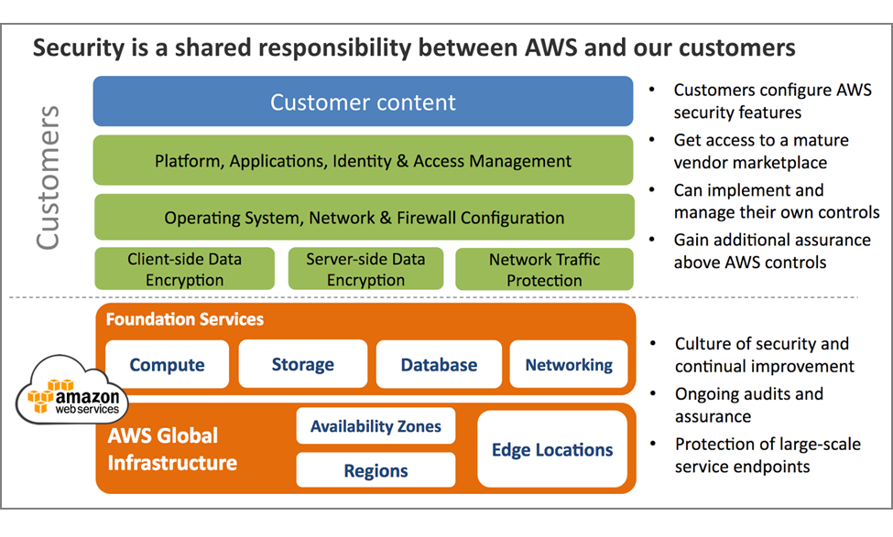
AWS Shared Security Model

Slide 49
AWS Network Security
AWS network and Amazon network use similar infrastructure, but are logically separated from one another.
AWS prevents IP spoofing: instance sending data with an IP or MAC address that’s not it’s own.
Network port scans must be approved by AWS in advance.

Slide 50

Web Application Firewall (WAF)
Managed service which protects your web applications from common attacks.
SQL injection
Cross-site scripting
Create custom security rules using web console or API
Deploy as part of CloudFront, ALB, or API Gateway

Slide 51

Shield
Managed service which protects your application from Distributed Denial of Service (DDos) attacks.
Network layer 3 and 4 attacks
Available in either standard or advanced tier depending on resources being protected.

Slide 52

GuardDuty
Threat detection service which continuously analyzes logs from CloudTrail, VPC network traffic (Flow Logs), and DNS logs.
Trigger alerts to notify staff about anomolies or automatically remediate issues.

Slide 53

Certificate Manager
Service which allows you to generate and deploy SSL/TLS certificates for use with AWS services.
ELB
CloudFront
API Gateway
Certificates are available for free, but only work with AWS resources.

Slide 54

Key Management Service (KMS)
A service which allows you to create encryption keys for use across a variety of AWS services.
Keys for encrypting S3 buckets
Keys for encrypting AMIs
Control access to encryption keys using policies and audit access to keys.

Slide 55

Security Hub
Provides a comprehensive view of high-priority alerts and compliance issues across accounts.
Security Information and Event Management (SIEM)
Single site which integrates alerts from various AWS services
GuardDuty
Inspector
Macie
Third-party AWS partners

Slide 56
Top 5 Cloud Security Issues
Stolen access credentials
Use multi-factor authentication to mitigate
Compromised access keys
Never publish keys on Internet in source code
Rotate keys daily
S3 bucket is publicly available
Use AWS Config to monitor account for public buckets
Third-party tools like Threat Stack
Permissive security group rules
Review and test all rules to make sure only required ports are accessible
Set both ingress and egress rules
Improperly scoped role/policy associated with resource
Only give resources the minimal amount of access needed to complete work

